Slide 1
MONDAY COFFEE
START YOUR WEEK WITH A SIP
"Bold flavor for a bold life."
By- Veath Prakash Balaji.

Slide 2
AGENDA
1. INTRODUCTION
2. ABSTRACT
3. PROBLEM DEFINITION
4.OBJECTIVE
5.INTRODUCTION TO SQL
6.ANALYSING QUERIES

Slide 3
INTRODUCTION
Coffee plays a significant role in both personal and economic aspects of life. As one of the most popular beverages worldwide, it provides not just a caffeine and also boost our energy and give instant refreshment.
This project aims to leverage the power of Structured Query Language (SQL) to manage and analyze a comprehensive dataset encompassing various CUSTOMERS FROM VARIOUS CITY,VARIOUS CUSTOMERS,PRODUCTS AND SALES.

Slide 4
ABSTRACT
This project explores the integration of SQL (Structured Query Language) to effectively manage and analyze data for a coffee shop.
As businesses grow, the need for efficient data management becomes critical to ensure smooth operations.
This project demonstrates how SQL can be used to support day-to-day business activities and strategic decision-making.

Slide 5
Problem definition
Managing the operations of a coffee shop involves handling large amounts of data related to City, Sales, Products, Customers. Without a proper system in place, manually tracking and analyzing this data can lead to Inefficient Inventory Management, Unorganized sales Data, Inconsistent Customer Experience, Time-Consuming Employee Management, Limited Reporting and Analytics.
This project aims to solve these problems by designing a relational database using SQL.

Slide 6
objectives
The goal of this project is to analyze the sales data of Monday Coffee, a company that has been selling its products online since January 2023, and to recommend the top three major cities in India for opening new coffee shop locations based on consumer demand and sales performance. Using SQL we can Achieve

Slide 7
INTRODCTION TO MYSQL
SQL (Structured Query Language) is the standard language used to communicate with relational databases. It allows users to create, retrieve, update, and manage data efficiently. With SQL, you can interact with databases to organize data in meaningful ways, making it easy to generate insights and reports.
Some common SQL operations include:
SELECT: Retrieve specific data from a table.
INSERT: Add new records to a table.
UPDATE: Modify existing data.
DELETE: Remove unwanted records.

Slide 8
Understanding the consumer base, analyzing competitors, and exploring the market dynamics is crucial for a coffee shop's success. By tailoring offerings to meet consumer preferences and differentiating from competitors, coffee shops can position themselves effectively in the market.
Consumer
Competitor
Market

Slide 9
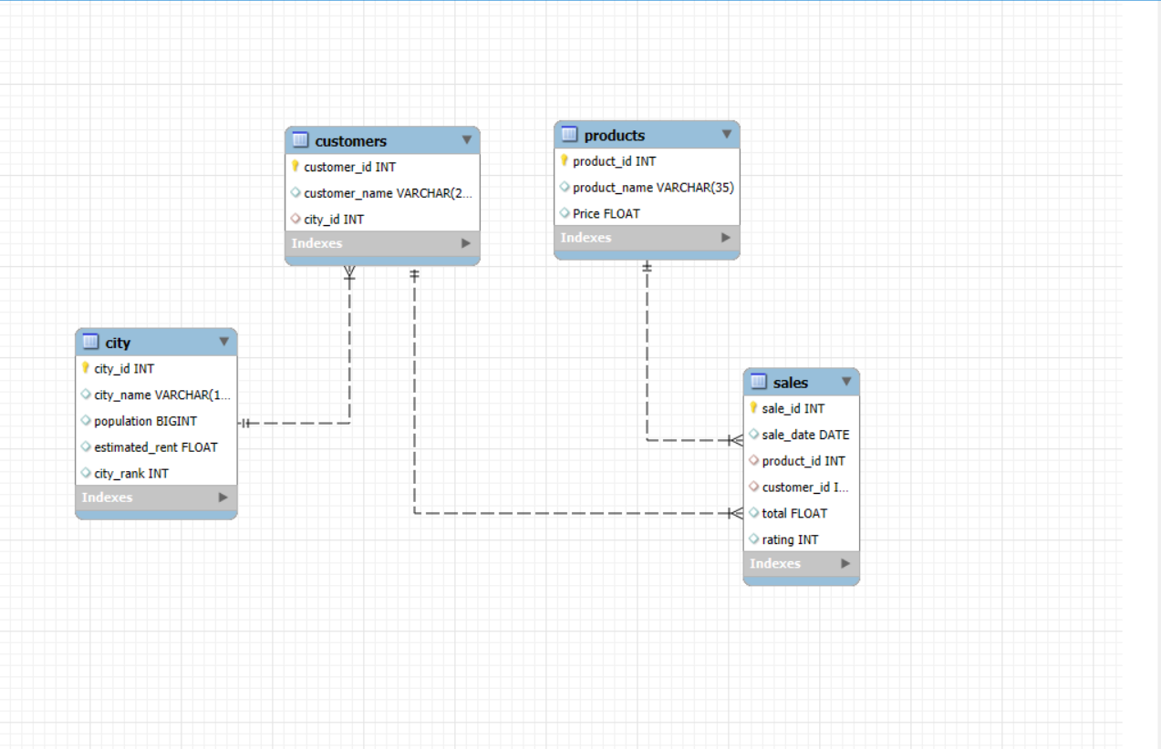
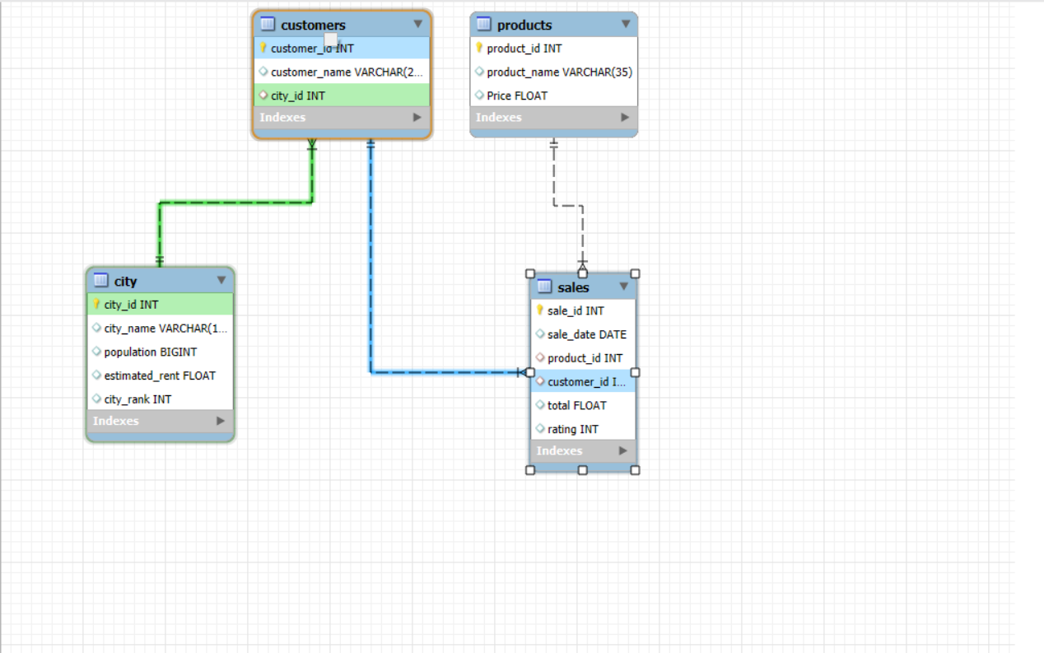
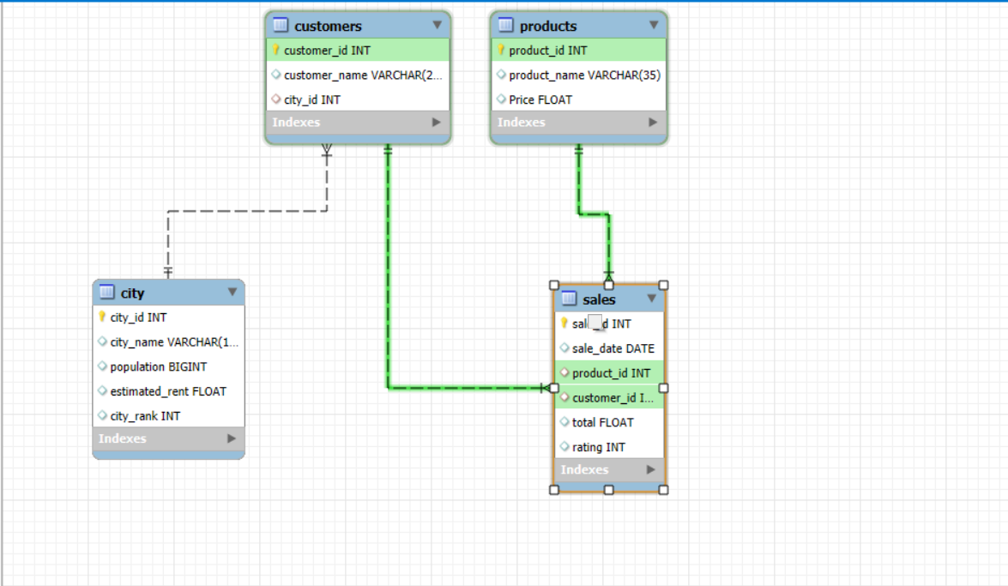
ER stands for Entity-Relationship in the context of databases. An Entity-Relationship. (ER) diagram is a type of flowchart used to visually represent the relationships between entities in a database. It helps in database design by defining the structure of data and how different entities are related.
ER DIAGRAM

Slide 10
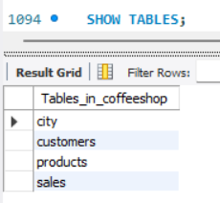
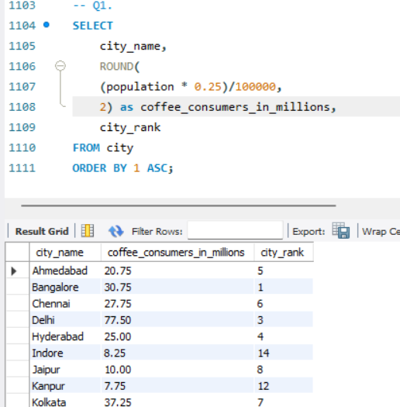
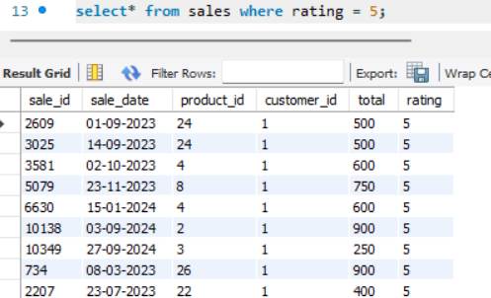
Q1. SHOW THE TABLES ?
Q2.HOW MANY PEOPLE IN EACH CITY ARE ESTIMATED TO CONSUME COFFEE,GIVEN THAT 25% OF THE POPULATION DOES?
Q3.SHOW THE PRODUCTS THAT ARE 5 STAR RATING?

Slide 11
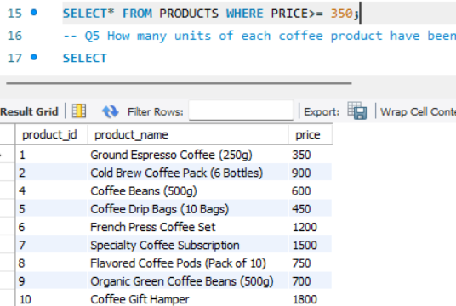
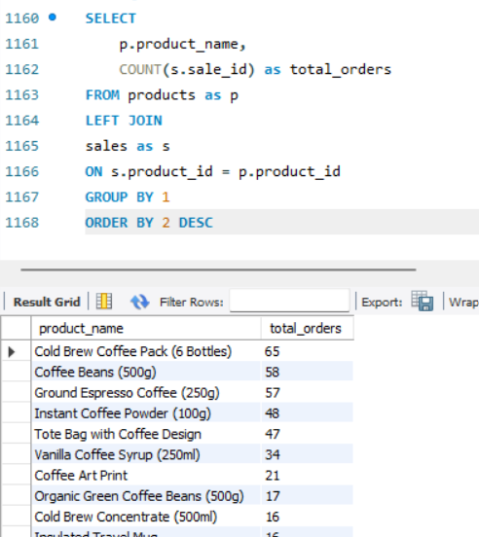
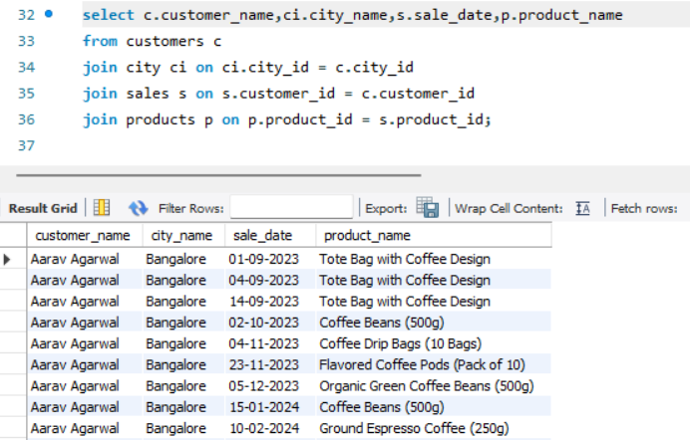
Q4. Display the products that are above or equal to Rs.350?
Q5.How many units of each coffee product have been sold?
Q6.Give the names of customers their city, date and what product they have consumed?

Slide 12
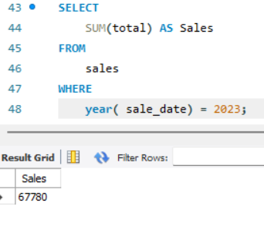
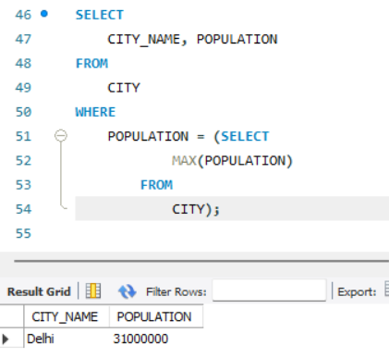
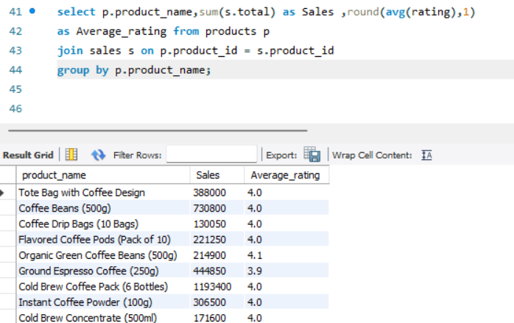
Q7.Total sales in Year 2023?
Q9.Which city has highest population?
Q8. Write Product name, sum of sales and average rating?

Slide 13
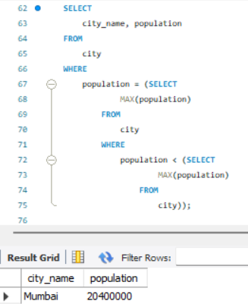
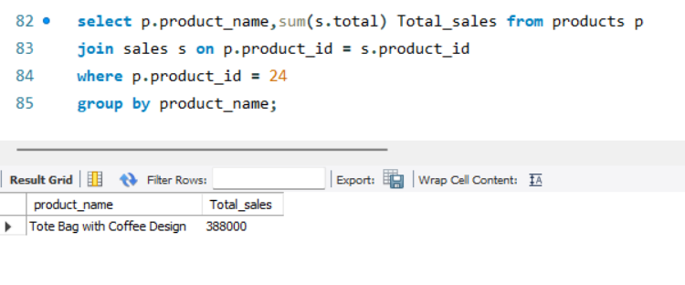
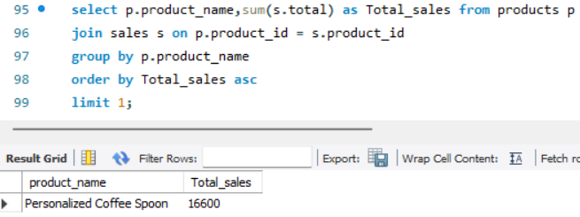
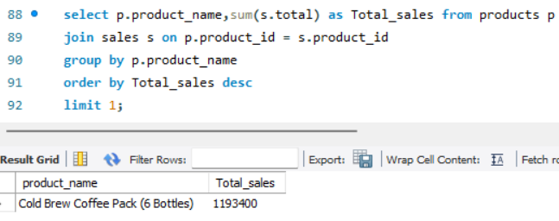
Q10. Second Highest Population of city with name?
Q11. What is total sales of Product id 24?
Q13. Which Product is sold Less?
Q12. Which Product is sold more?

Slide 14
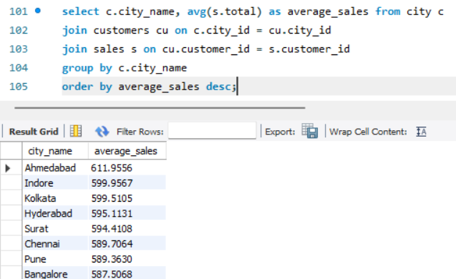
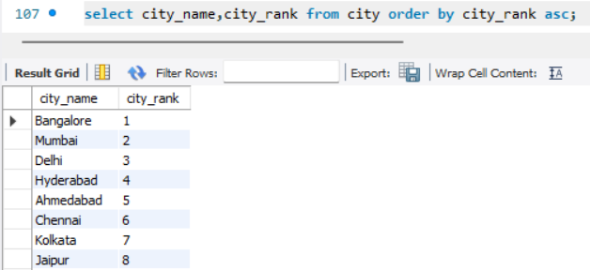
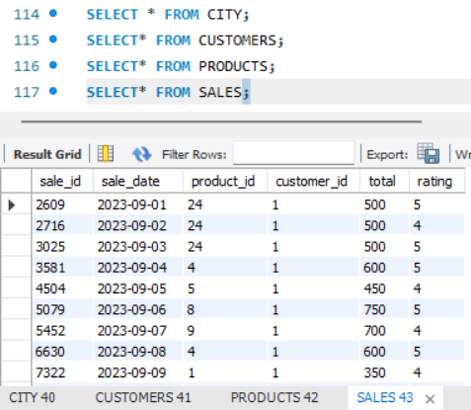
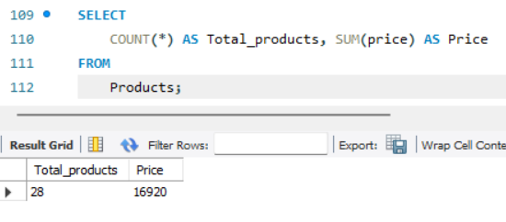
Q14. Average sales in each city?
Q15. Order the city name in the order of city_rank?
Q17. To view the datas?
Q16. Total Products and Their Price

Slide 15
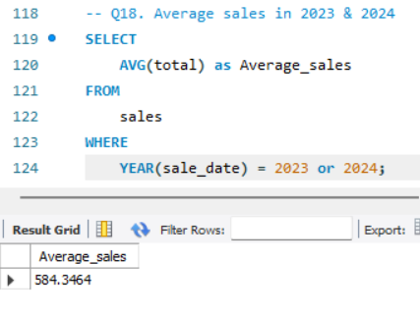
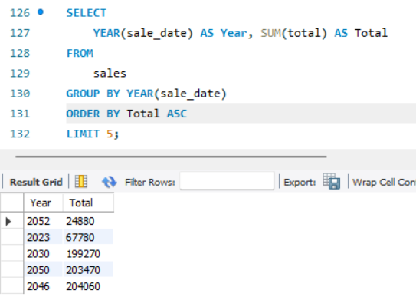
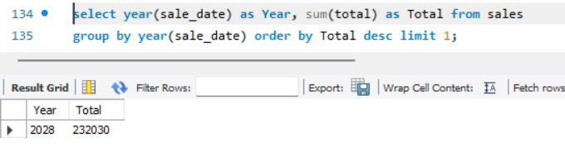
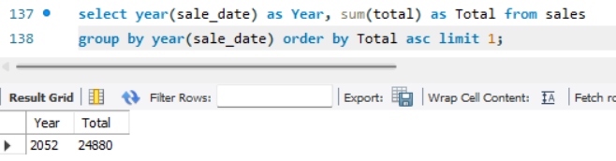
Q18. Average sales in 2024
Q19. which year has High sales any 5 years ?
20. Which Year has High sales?
Q21. Which Year has Low sales?

Slide 16
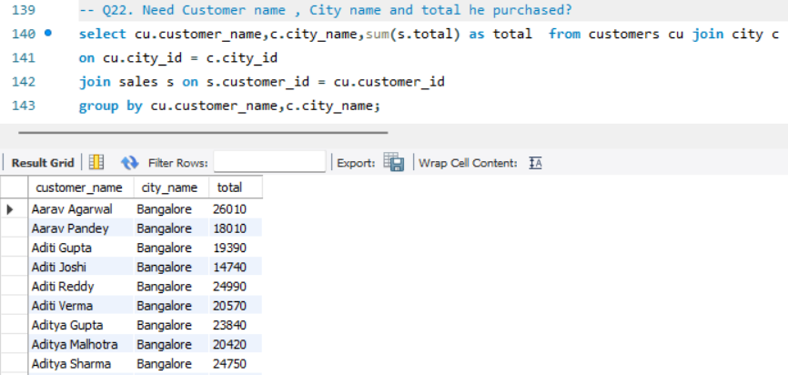
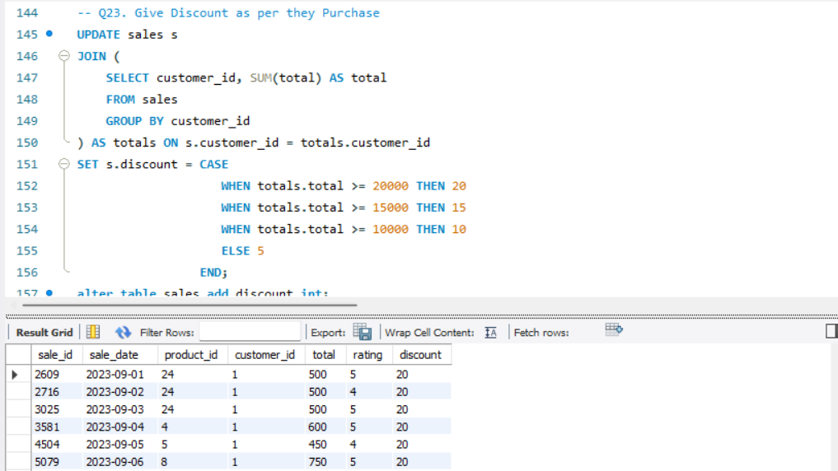
Q22. Need Customer name , City name and total he purchased?
Q23.Give Discount as per they Purchase

Slide 17
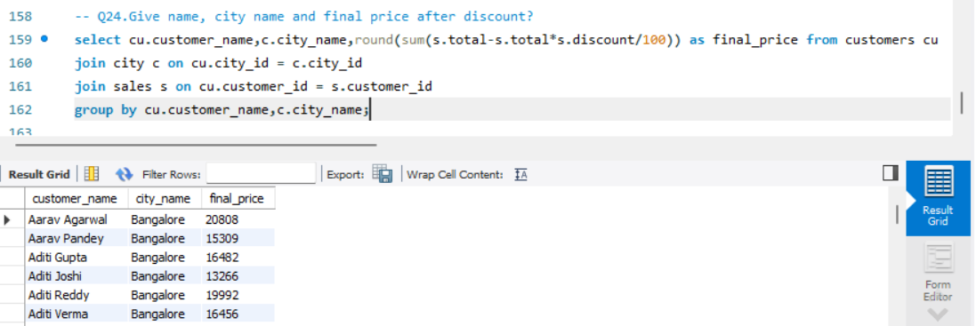
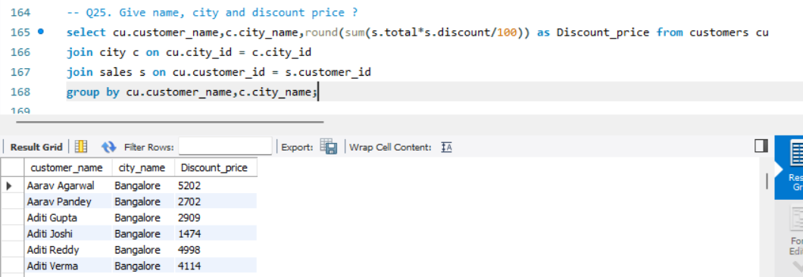
Q24. Give name, city name and final price after discount?
Q25. Give name, city and discount price ?

Slide 18
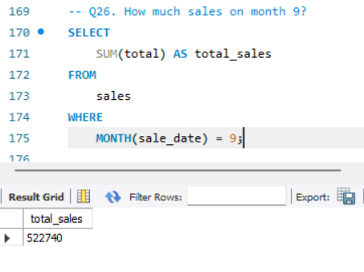
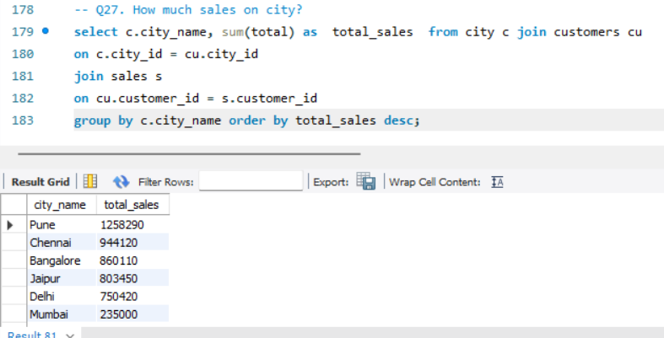
Q26. How much sales on month 9?
Q27. How much sales on city?

Slide 19
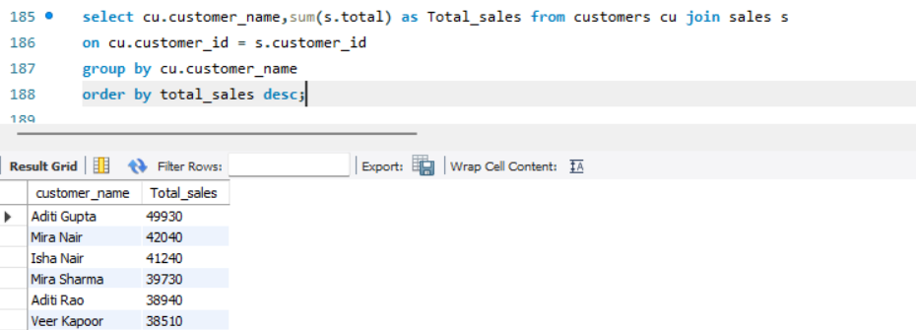
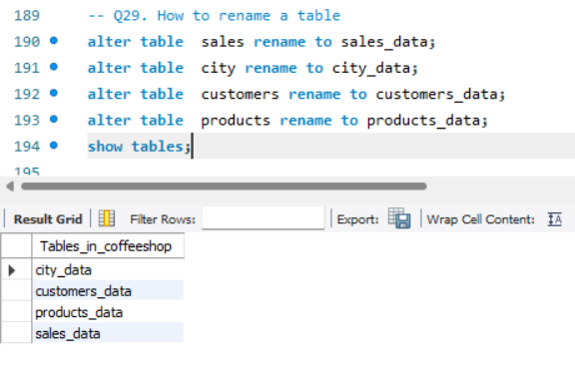
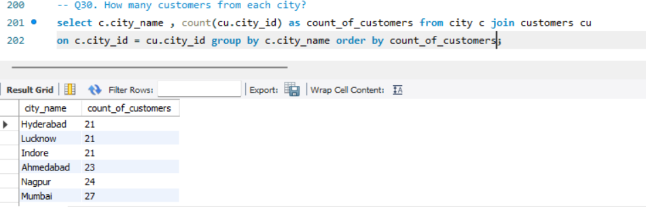
Q28. How much did each customers had purchased in my shop ?
Q29. How to rename a table
Q30. How many customers from each city?

Slide 20

Key to Success FOR A BUSINESS
Better Sales
Quicker Responses
Better Customers
Better Service
More Products

Slide 21

Thank You

